Slide 1
Title: A Comparative Analysis of Machine Learning Classifiers for Early-Stage Diabetes Prediction to Identify the Best Performing Classifier
By
Md Junayed Rahman Sumon

Slide 2
INTRODUCTION
Diabetes Overview: Diabetes is a prevalent chronic disease affecting millions globally, with serious complications.
Goal: Identify the best performing machine learning classifier for early-stage diabetes prediction.

Slide 3
Literature Review
Classifiers Considered: Decision Tree, Random Forest, XGBoost, CatBoost, and other baseline algorithms initially explored such as Logistic Regression, Support Vector Machine, Naive Bayes Et cetera.
Insights from Literature: Boosting algorithms, particularly XGBoost and CatBoost, tend to perform well in prediction tasks.

Slide 4
Problem Statement
Challenge: Choosing the right model for accurate early diabetes prediction.
Objective: Compare Decision Tree, Random Forest, XGBoost, and CatBoost classifiers to identify the top performer.
Significance: Machine learning offers a promising method for predicting diabetes from symptom data.

Slide 5
Comparative Insights with Our System
Consistency with Literature: Like past studies, our project found XGBoost and Random Forest to be top performers, confirming their reliability in medical prediction.
Unique Contributions: Unlike some studies that used standard parameters, we conducted extensive hyperparameter tuning and tested the classifiers for different parameter values.

Slide 6
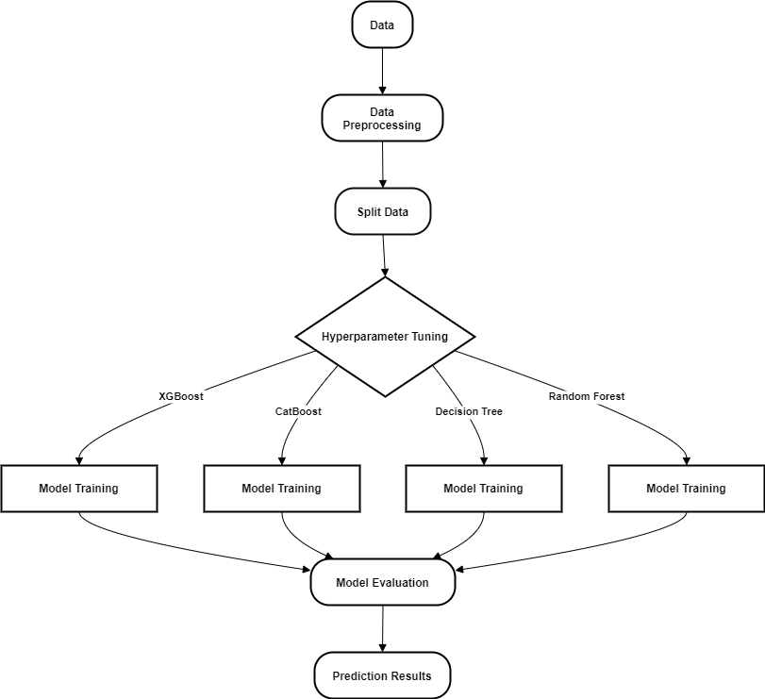
Block Diagram

Slide 7
Dataset and Features
Dataset Origin: Collected from Sylhet Diabetes Hospital, Bangladesh, via questionnaires.
Size: 520 rows, 17 columns (16 features + 1 target variable).
Target Variable: "Class" (1 = Positive for Diabetes, 0 = Negative for Diabetes).

Slide 8
Data Preprocessing
No Missing Values: Ensured all fields were complete.
Feature Scaling: Converted all categorical data to integers for compatibility with models.
Train-Test Split: 70% training, 30% testing split to evaluate models on unseen data.

Slide 9
Classifiers and Methodology
Implemented Classifiers: Decision Tree, Random Forest, XGBoost, CatBoost.
Why These Models?
Hyperparameter Tuning: Grid Search.
Evaluation Metrics: Accuracy, Precision, Recall, F1 Score, and Confusion Matrix.

Slide 10
Results
Classifier | Accuracy
Decision Tree | 98.08%
Random Forest | 98.08%
XGBoost | 98.08%
CatBoost | 97.44%

Slide 11
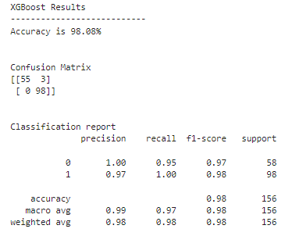
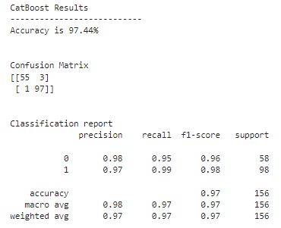
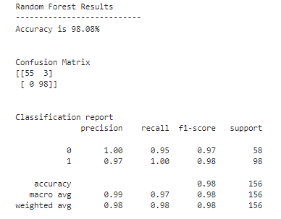
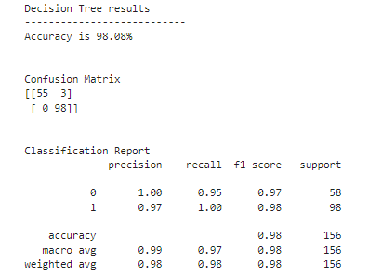
Results
Decision Tree, Random Forest, and XGBoost performed equally well; CatBoost was slightly lower.

Slide 12
Test Results of the Classifiers with Different Parameter Values
Tree Size | Decision Tree | Random Forest | XGBoost | CatBoost
5 | 95.51% | 96.15% | 98.08% | 98.08%
10 | 98.08% | 98.08% | 98.08% | 97.44%
50 | 98.08% | 98.08% | 98.08% | ----------------
100 | 98.08% | 98.08% | 98.08% | -----------------
2 | ---------------- | ---------------- | ---------------- | 96.15%
15 | ---------------- | ---------------- | ---------------- | 97.44%

Slide 13
Conclusion and Future Work
Conclusion: Decision Tree, Random Forest, and XGBoost are equally effective for early diabetes prediction on this dataset.
Future Directions: Collecting more data to enhance model accuracy and add more features and advanced models.

Slide 14


